Slide 1




Human Target Detection and GPS Transmission Vehicle
Team ID -10146
Akula Sandeep Kumar
Mitta Shiva Sai Vardhan
Merugu Naveen
Under the mentorship of,
Sumit Sunil Sartale

Slide 2

Project Objectives
Problem Statement
Project Overview – Introduction
End Users
Wow Factor in Project
Modelling/Block Diagram/Flow of Project
Result/outcomes
Conclusion
Future Perspective

Slide 3

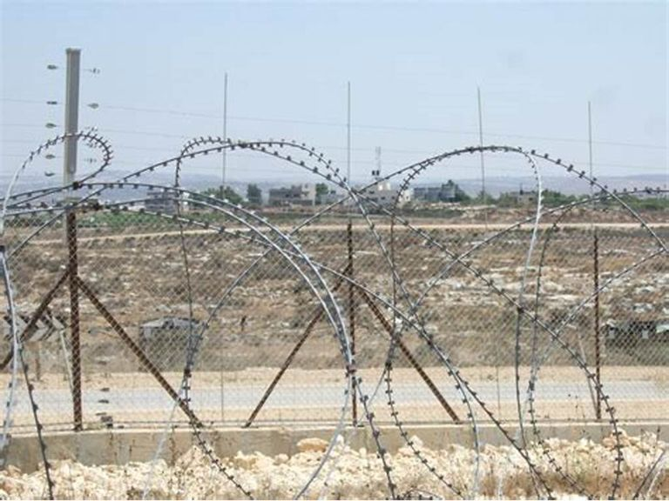

Problem Statement
Ensuring effective surveillance and timely response in security-sensitive areas, such as military zones, disaster-stricken regions, or remote locations, remains a critical challenge. Manual monitoring methods are often inefficient, prone to human error, and may pose risks to personnel. The lack of an automated, reliable solution for detecting human targets and transmitting their precise GPS location hampers operational efficiency and decision-making. This project aims to develop an advanced, vehicle-based system capable of accurate human target detection and seamless real-time GPS data transmission, addressing the need for enhanced situational awareness and response capabilities.

Slide 4
Project overview - Introduction
Autonomous Vehicle-Based System: A vehicle designed to navigate and monitor areas for human presence autonomously.
AI-Powered Human Detection: Uses computer vision and deep learning models to accurately identify humans in different environments.
GPS-Based Location Tracking: Integrated GPS module to pinpoint and transmit the exact location of detected humans.
Wireless Data Transmission: Utilizes Wi-Fi / ESP8266 to send real-time alerts and location data to monitoring stations.
Sensor Integration: Combines camera, Motors and GPS sensors for enhanced detection accuracy.
Remote Monitoring and Control: Operators can track and manage the vehicle’s movements via applications.
Energy-Efficient Design: Optimized battery usage with potential integration of renewable energy sources for extended operation.
Versatile Applications: Suitable for military surveillance, disaster rescue, security patrols, and remote monitoring.

Slide 5
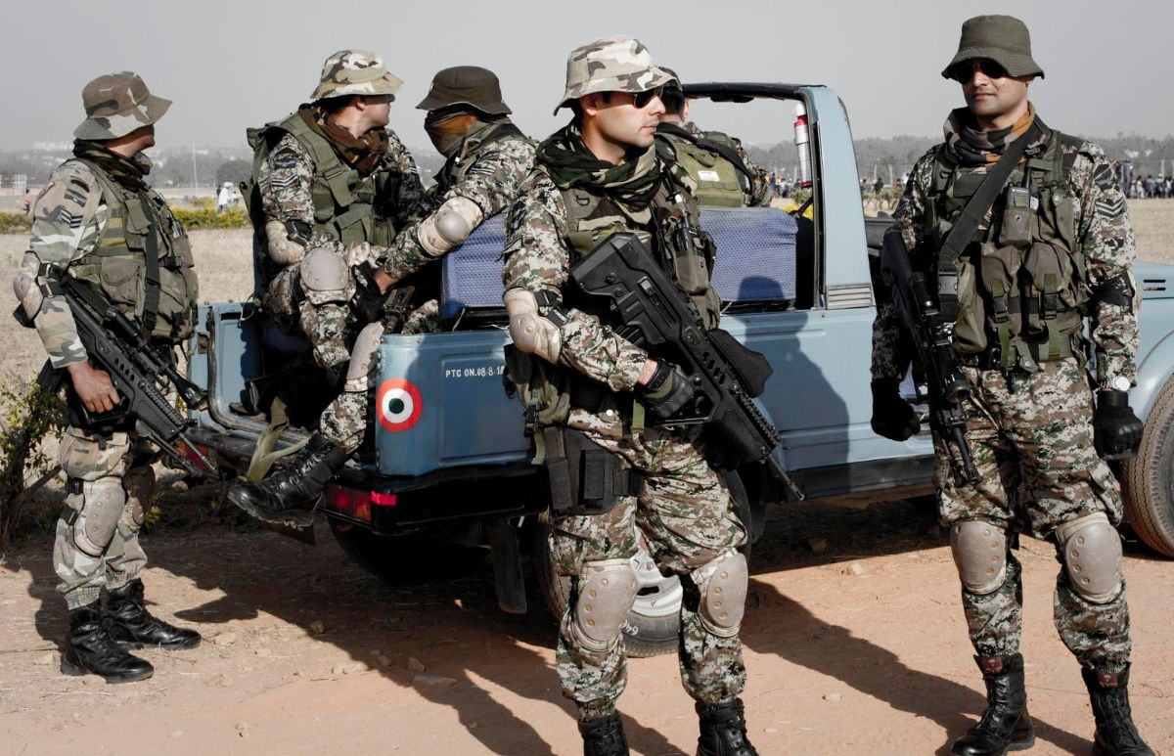



End User

Slide 6
Wow Factor in Solution
1. AI-Powered Human Detection
Uses MediaPipe AI for face detection.
Automatically identifies and tracks humans.
2. Real-time GPS Location Sharing
NEO-6M GPS sends precise coordinates.
Live updates via MQTT & Wi-Fi for remote monitoring.
3. AI-Based Decision Making
ESP8266 processes AI logic to decide movements.
Autonomous navigation toward detected targets.
4. Wireless Remote Control & Monitoring
ESP8266 + MQTT enables real-time remote tracking.
End users receive live alerts & video feeds.
5. Energy-Efficient Power System
Rechargeable Li-ion battery powers all modules.
Optimized for longer operational time.
6. Multi-Purpose Applications
Security & Surveillance – Detect intruders.
Search & Rescue – Identify stranded people.
Military Patrols – Autonomous defense.

Slide 7
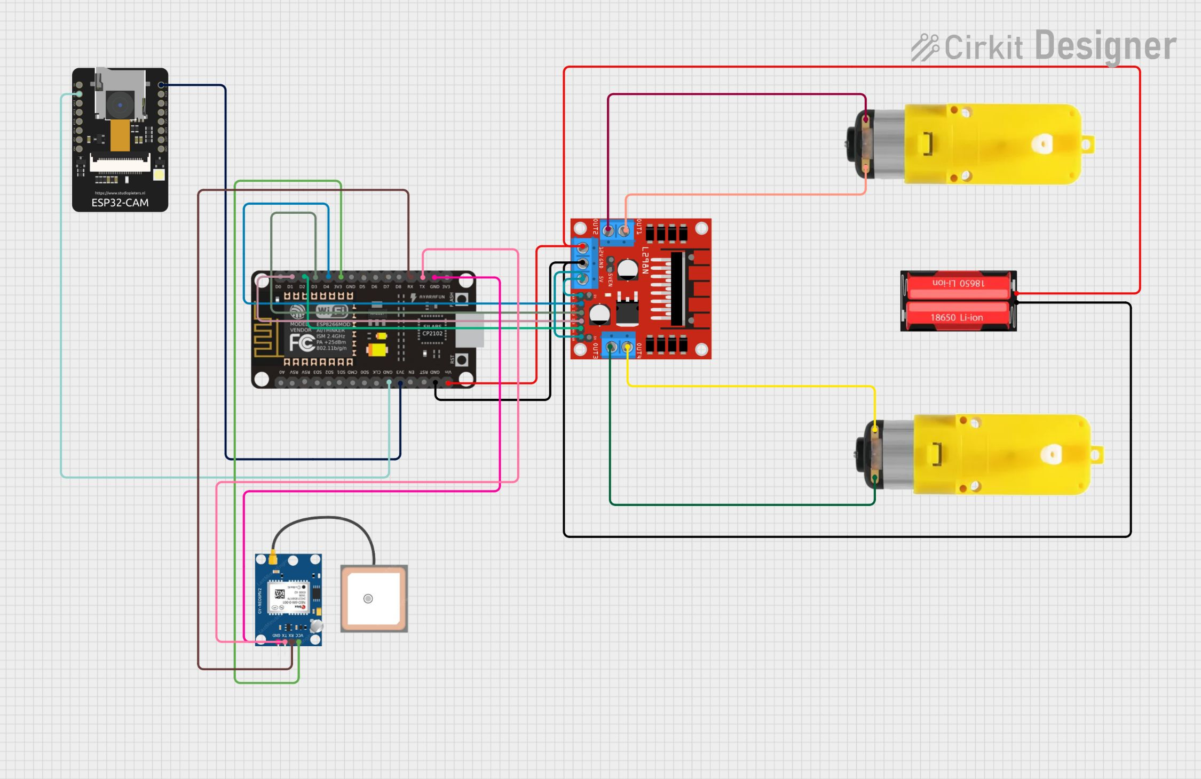
Modelling

Slide 8
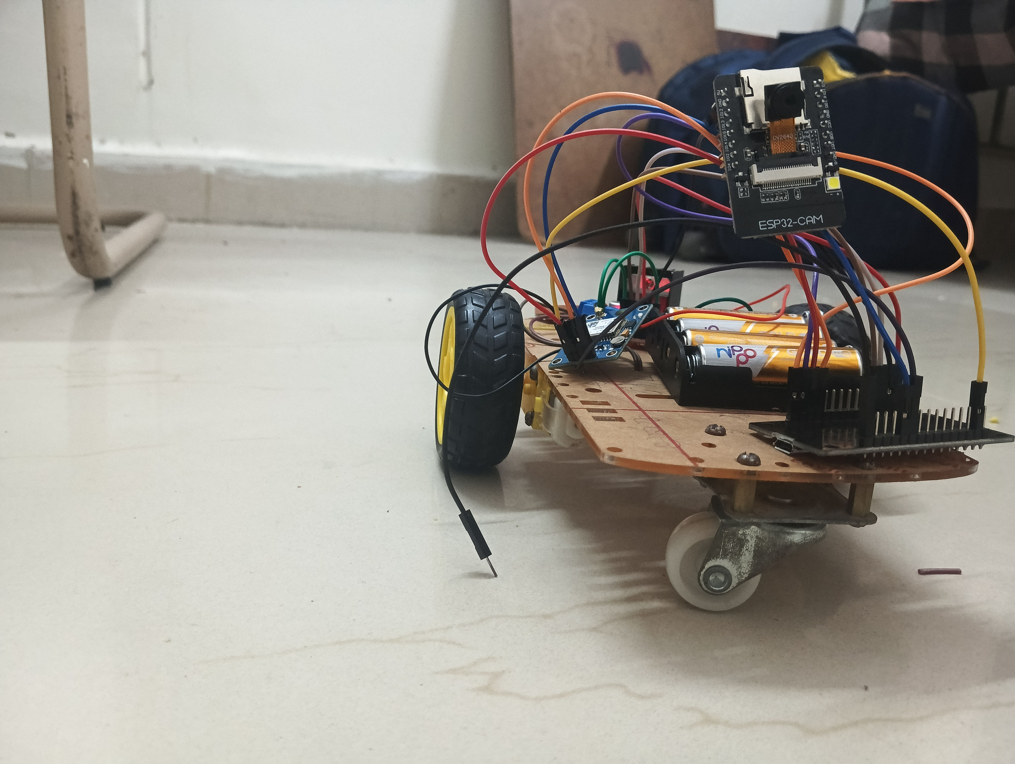
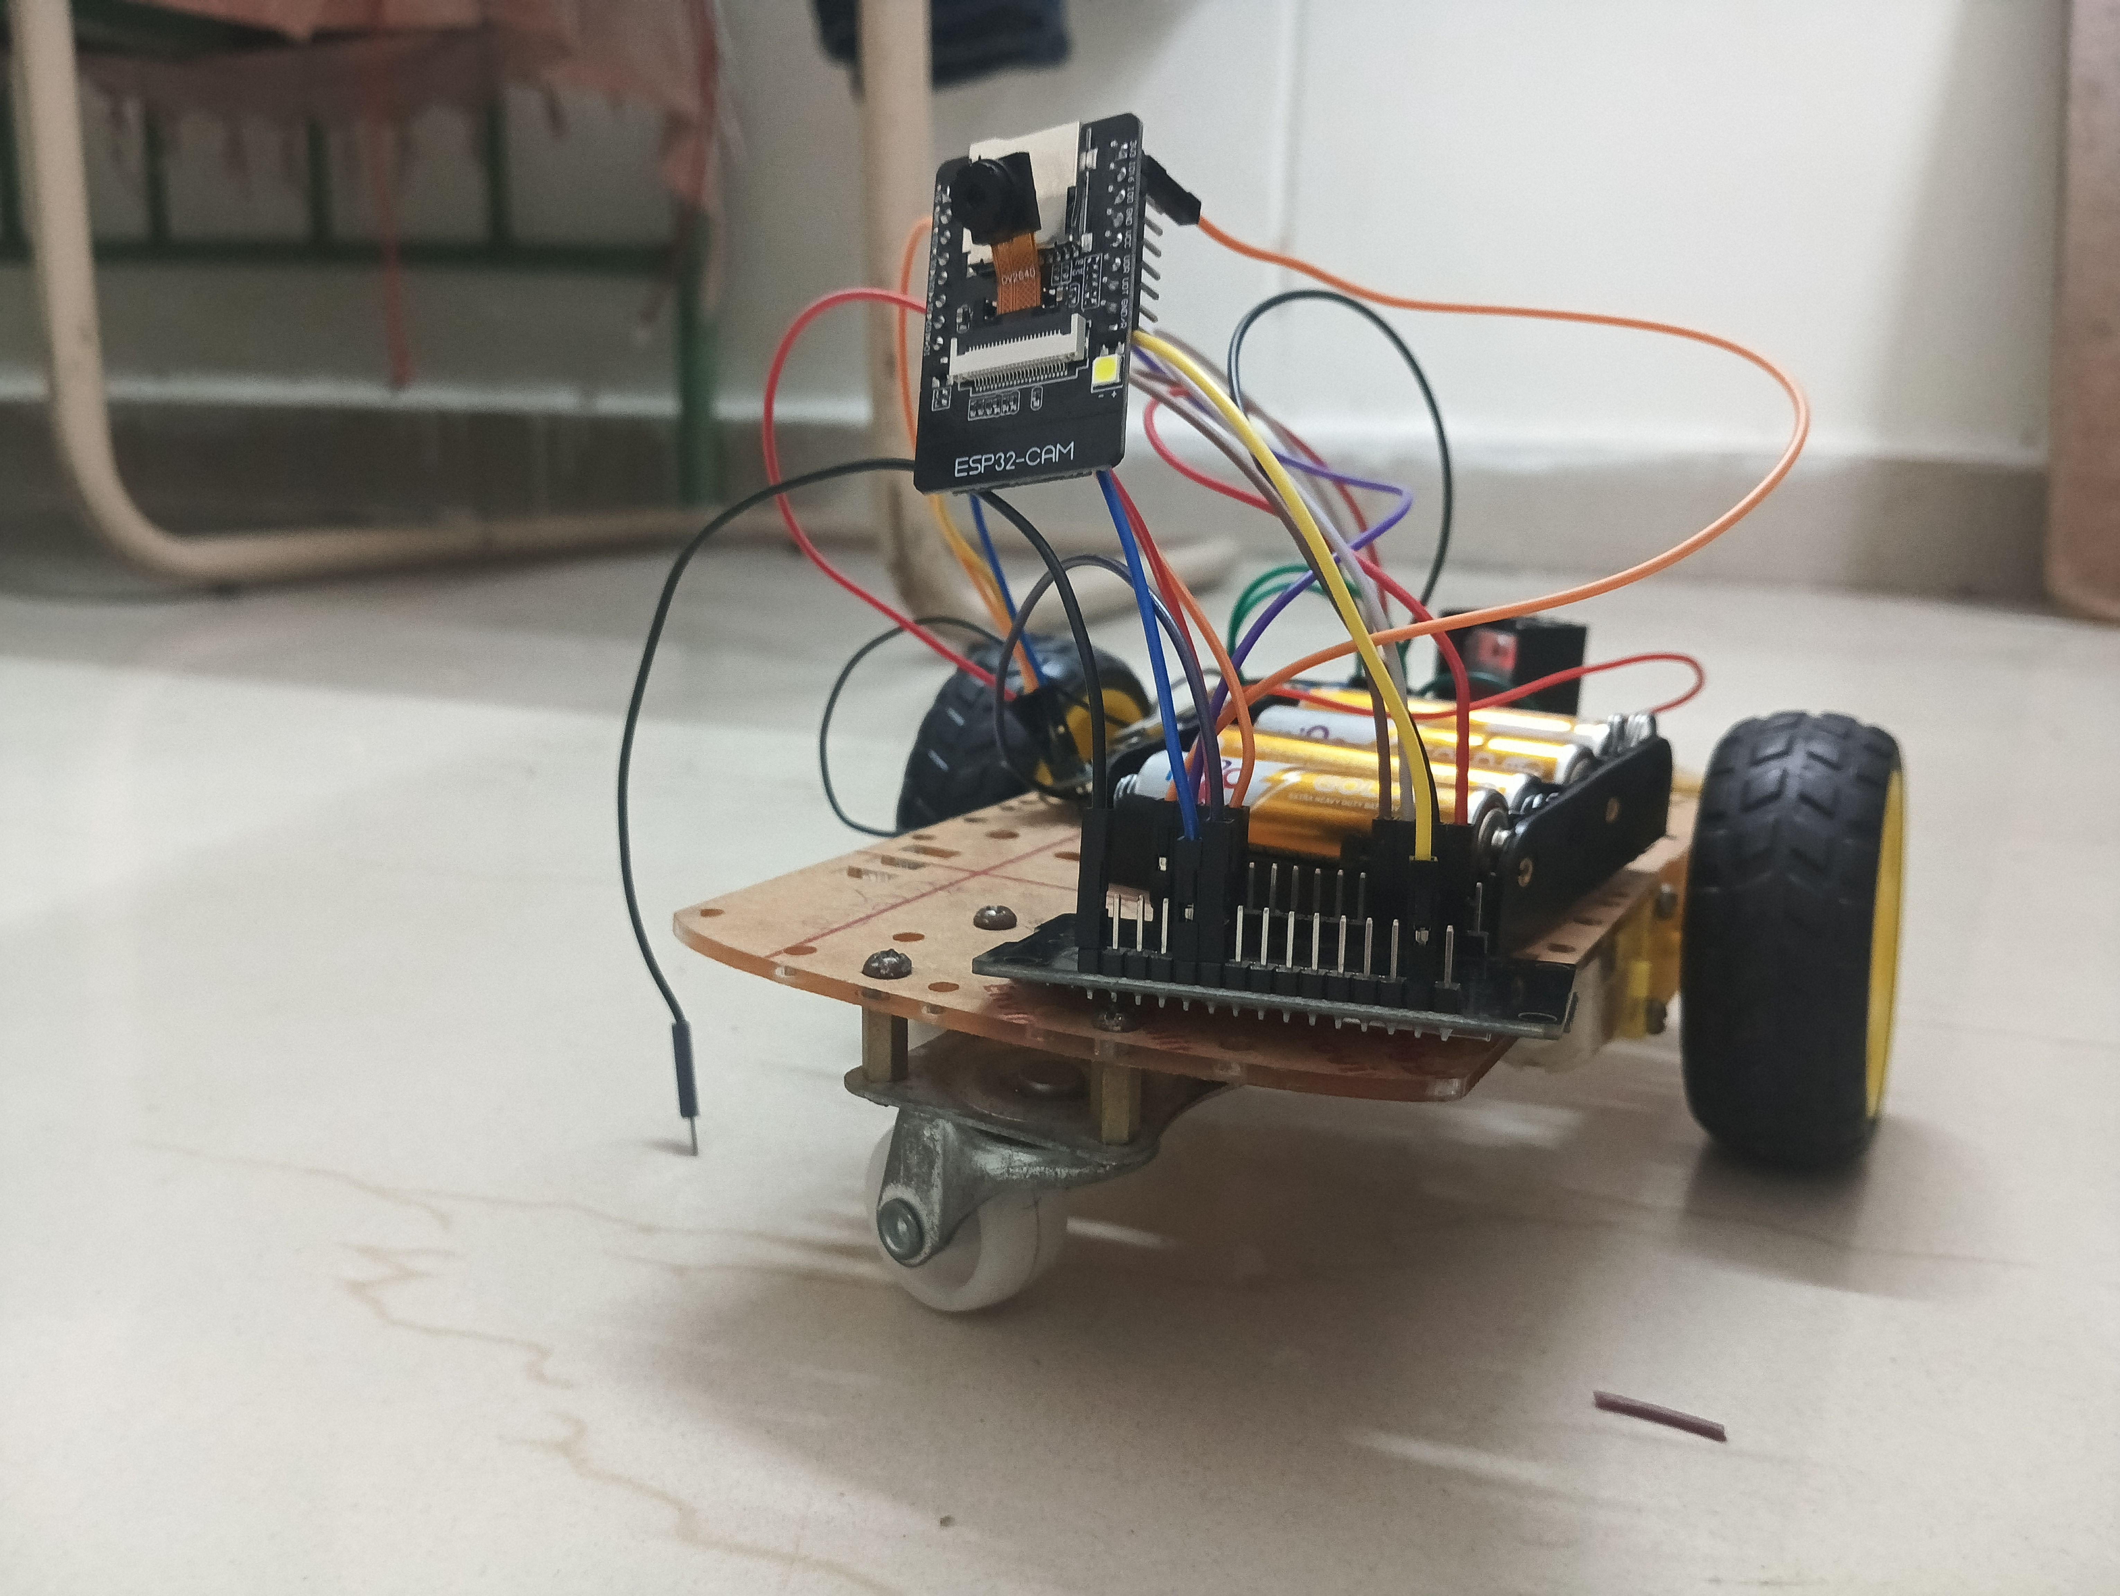
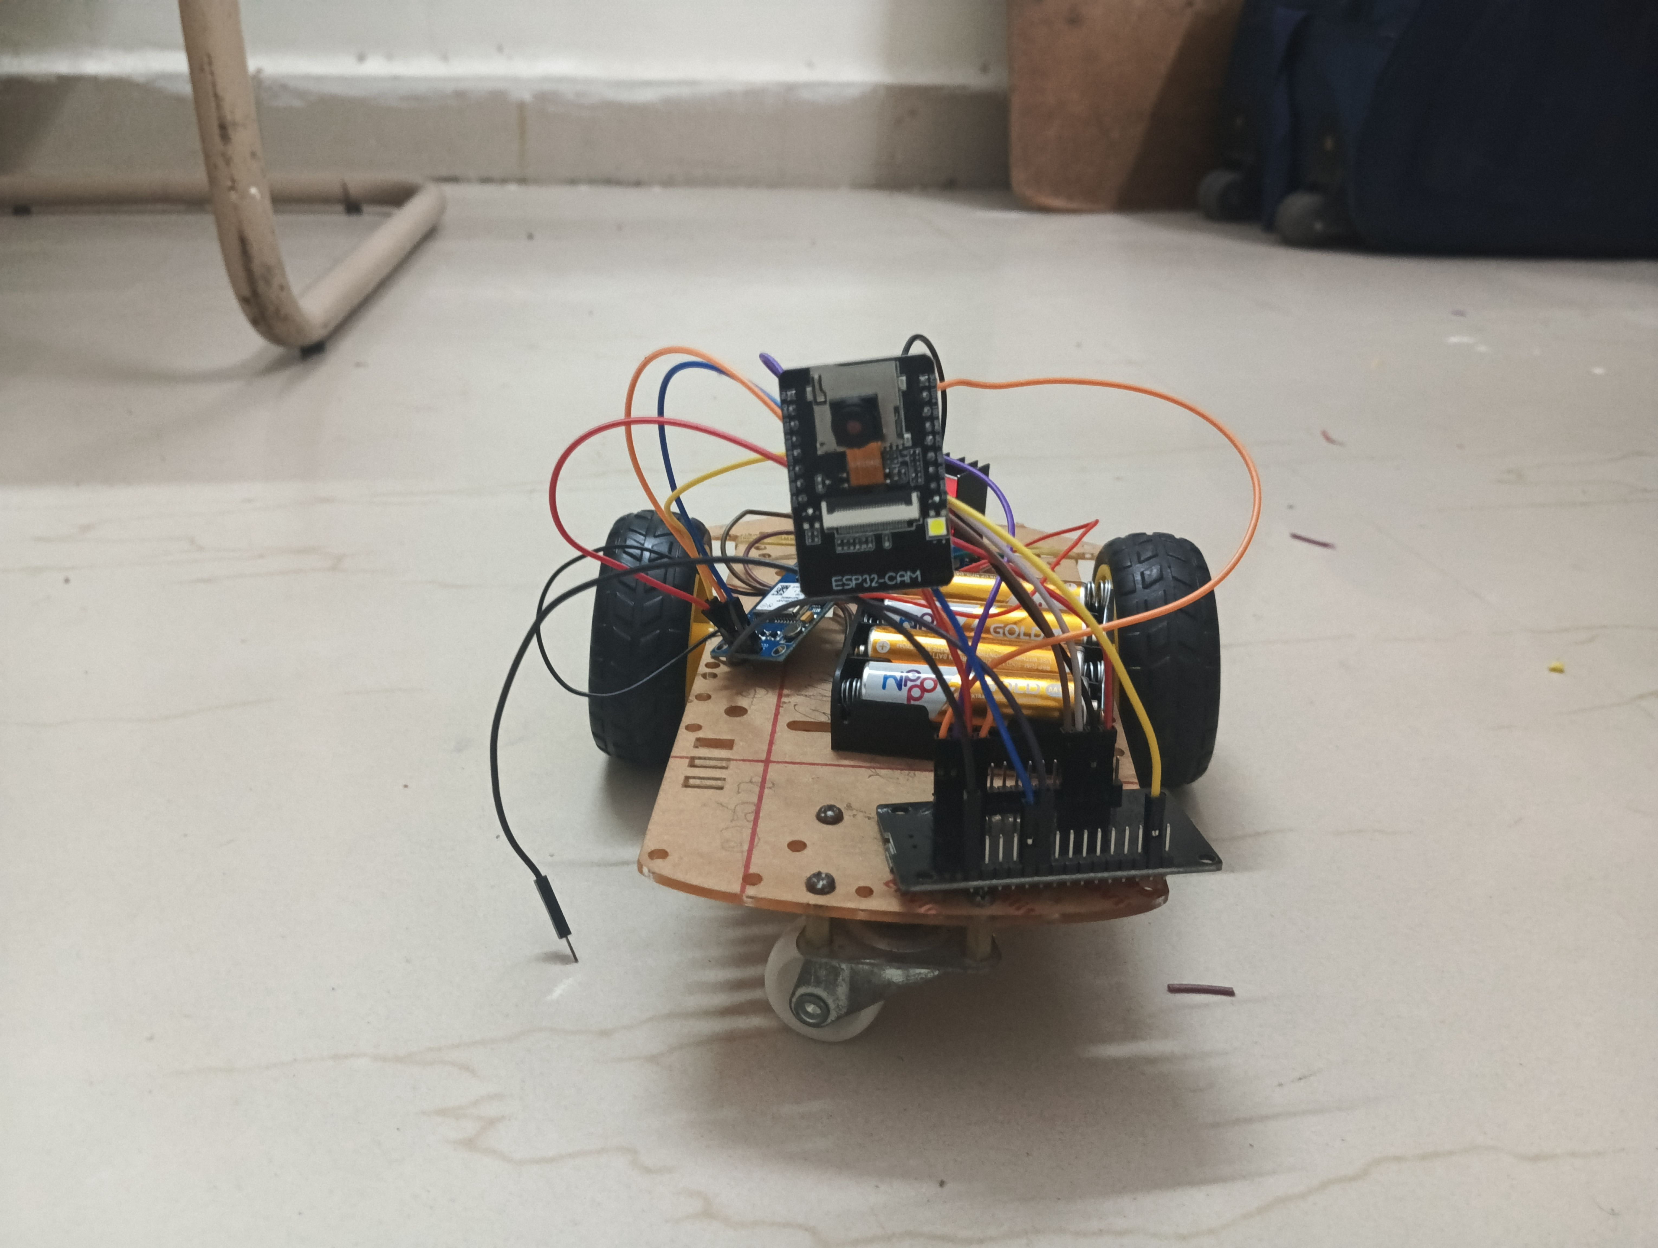
Result / Outcomes

Slide 9
Conclusion
The Human Target Detection and GPS Transmission Vehicle is a real-time, AI-powered autonomous system that integrates face detection, GPS tracking, and remote control capabilities using an ESP8266-based IoT framework. By leveraging Mediapipe for face detection, MQTT for communication, and NEO-6M for GPS tracking, this system effectively detects human targets and transmits their locations to end users. The motor driver (L298N) and decision-making AI work together to control vehicle movements based on detection results, ensuring automated navigation. The inclusion of a battery-powered system makes it suitable for remote and outdoor operations.

Slide 10
Future Perspective
Enhanced AI-Based Object Detection – Expanding beyond face detection, the system can be upgraded to recognize multiple objects, such as animals, vehicles, or specific human postures.
Autonomous Navigation – Implementing LiDAR or ultrasonic sensors to allow the vehicle to avoid obstacles and operate independently in complex environments.
Integration with Cloud AI Services – Offloading image processing to cloud-based AI models for faster and more accurate detection.
Extended Communication & Range – Using LoRa or 5G instead of MQTT for long-distance communication to improve real-time remote tracking.
Solar-Powered Operation – Integrating solar panels to improve battery efficiency and support longer autonomous missions.
Multi-Vehicle Coordination – Implementing swarm intelligence for multiple detection vehicles to work collaboratively in search and rescue missions

Slide 11
Thank you...!
Notes:
11

